Slide 1
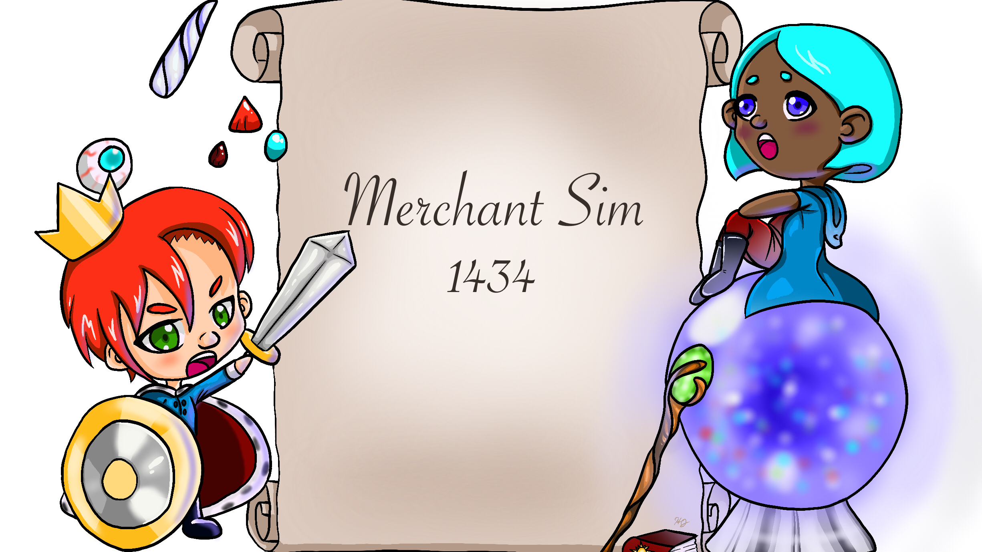
Custom Photo Placeholder
Computer Pub
Andrew Banks
Joshua Byers
Holland Johnson
Austin Rhodes
Dylan Sullenberger

Slide 2
Introduction
Web based clicker game based on the stock market.
Fantasy theme to keep things fun and interesting.
Event, quest, and monarchy systems used to spice up gameplay and add element of randomness.
Lightweight and runs in any browser using only HTML, CSS, and JS

Slide 3
Customer Value
Our product provides a casual gaming experience for audiences of any age.
Players can try to play the odds by keeping track of events and paying attention to shifts in the monarchy…
…or can simply buy stocks and let the game run in the background.

Slide 4
Tech: Stock Prices
every day:
// RNG determines daily price shift
let move = rand() * vol
// Price will trend towards ‘bias’
if price > (bias + vol):
price += move
else if price < (bias – vol):
price -= move
else:
if coin_flip():
price += move
else:
price -= move
How do we simulate trading in a real time market?
Just three parameters:
Price
Bias
Volatility
Every second, the game updates the price of each stock based on RNG + these parameters.
All other systems only manipulate these values.

Slide 5
Tech: Bias
Controls the price that the stock will hover around
Useful for creating long-term movements up or down
Bias

Slide 6
Tech: Volatility
Controls the amount a stock can change per day
Increases the speed of rising and falling trends
Useful for creating short-term instability, or pushing a stock to a new bias faster
Volatility

Slide 7
Tech: Examples
Can create a wide variety of price movements
Gives players the opportunity to capitalize on random events or quest consequences
price += 8
bias += 8

Slide 8
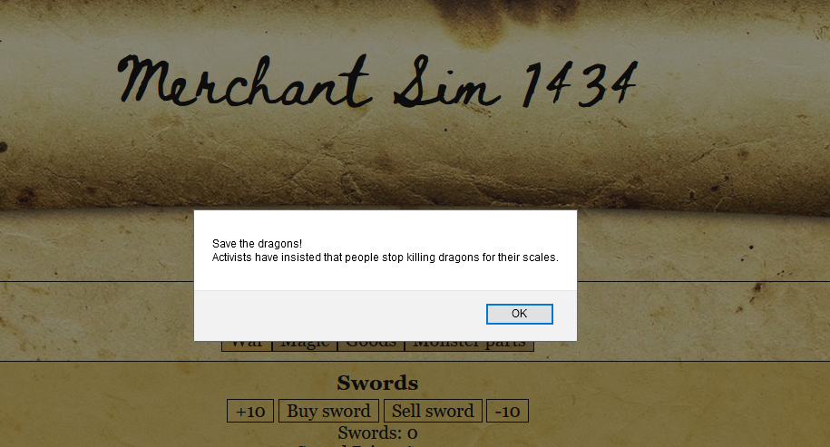
Tech: Event System
As time passes, dynamic events will occur that fit into the fantasy game world.
Events shift the bias and volatility of various stocks when they occur.
The shift in volatility is temporary to replicate real life stock movement, but the change in bias is permanent.
Save the dragons!
Activists have insisted that people stop killing dragons for their scales.
bias -= 5;
vol += 5;

Slide 9
Tech: Quests
Manipulate Wine Prices:
Cost: 25 gold
Cooldown: 60 seconds
Success! (90% Chance):
price *= 2
vol += 5
Fail, wine crash imminent (10% Chance):
price /= 2
bias /= 2
Offer a risk/reward opportunity
Cost money to begin, but usually yield multiplicative rewards.
Some quests can fail dramatically, with players losing a lot of gold.

Slide 10
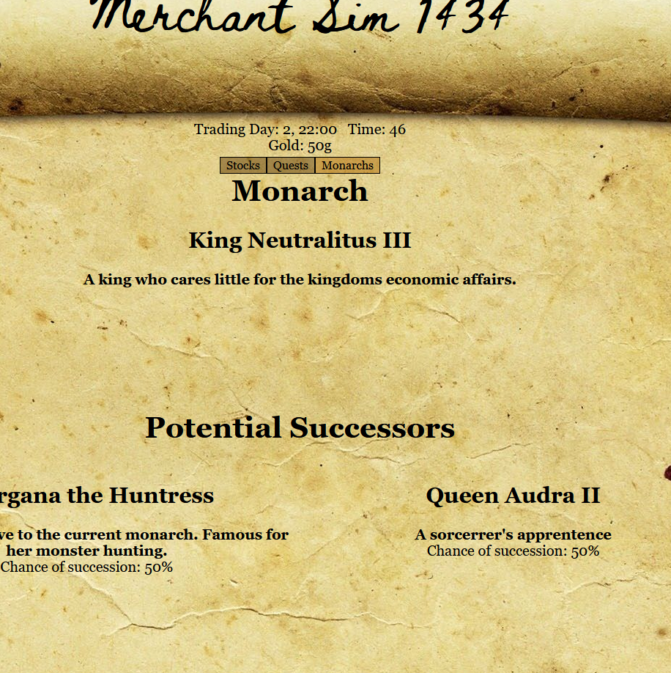
Tech: Monarch System
The fictional kingdom where the game is set is always ruled by a monarch.
Every monarch has special interests that affect entire categories of stocks.
After a while, the current monarch will be replaced with a new one.
The player can view the possible successors and see the percentage of them becoming the next monarch.

Slide 11
[ Remove this slide, use your version]
Andrew Banks – Backend developer (Focused on Event and Monarch systems).
Austin Rhodes – Backend developer (Focused on Stock and Quest systems)
Joshua Byers – Frontend developer (CSS and Layout)
Holland Johnson – Art director
Dylan Sullenberger – Assisted with backend and frontend where needed.

Slide 12
Project Management
The team met every Tuesday and Thursday to discuss what needed to be completed for the week.
The team also constantly communicated through Discord to ask questions and share ideas and ask for help

Slide 13
Project Management
All the basic goals for the project were met. (Stock trading, quests, events, monarchs).
There were various other features the team was hoping to add if there was extra time.
Starting a guild for quests that could be leveled up, ability to become the monarch, magical items that can manipulate the market.
There were also some basic concepts that we did not think of until late into the project that were not completed. (Save systems, Stock portfolio).

Slide 14
Project Management
[1, 2, 3] + [4, 5, 6];
> '1,2,34,5,6'
Some time was lost due to:
Unfamiliarity with JavaScript
Unfamiliarity with interpreted languages
Unfamiliarity with a dynamically changing website
Unfamiliarity with type coercion.
Especially:
Getting over the GitHub learning curve to really begin collaborating.

Slide 15
Reflection – Design Process
Originally a more plan-driven approach
Things progressed very slowly
Switched to a more iterative, rapid-prototyping approach
Things progressed much faster (but were a little scuffed)

Slide 16
Reflection - Overall
The project went well, but there’s more work to be done to make a polished game.
The team worked well together; communication was easy.
Development was the cause of most our problems.

Slide 17
Demo

